Slide 1
Neuron B. Sc. I
Mrs. Dr. Manjri A. More
Department of Zoology GKG College Kolhapur

Slide 2
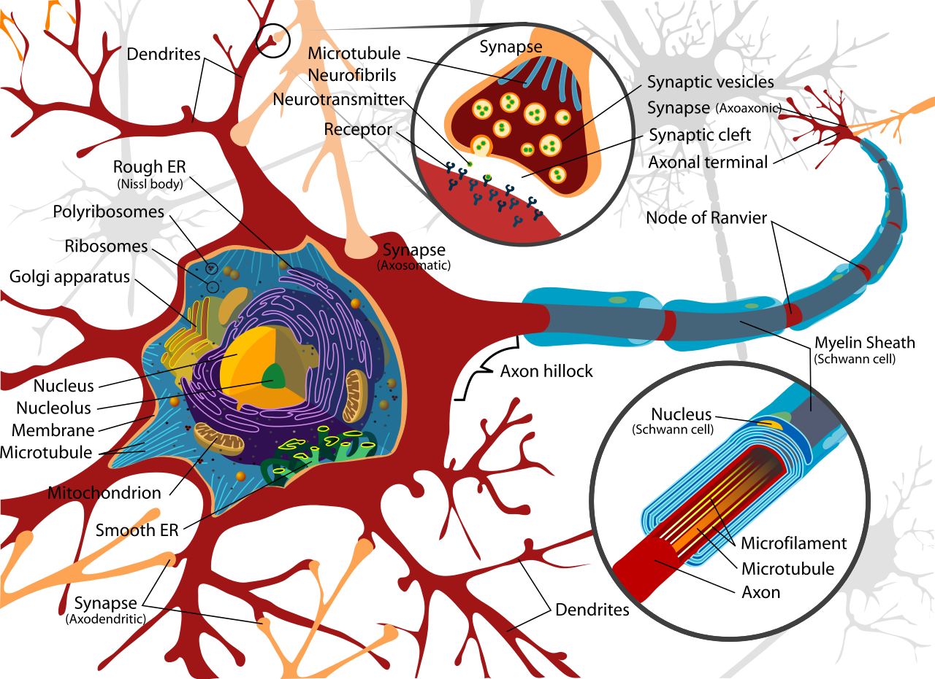
The cell body holds the nucleus.
It is the site of protein synthesis, which occurs on small
granules of rough endoplasmic reticulum called nissl substance.
In the nervous system, many neuronal cell bodies can group together to form a distinct
structure.
In the CNS, this is known as a nucleus, and in the PNS as a ganglion.
Each neurons usually give of single axon from a funnel shaped area called axon hillock
Action potential originate from the axon hillock and travels to small terminals of axons.
Cell body

Slide 3
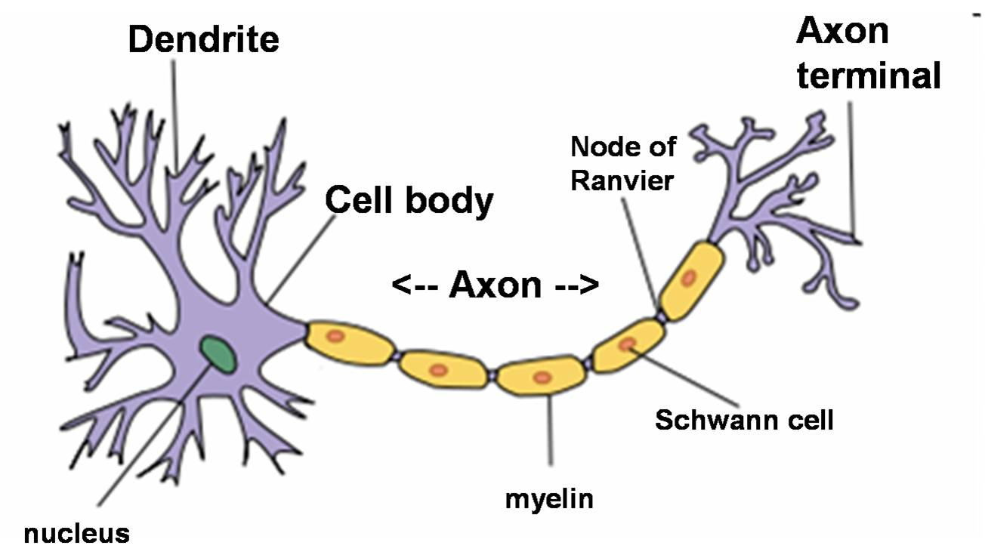
Cell body projected in the form of certain filamentous structure called dendrites
Contain- nissil substances, microtubules, mitochondria,.
It receives the signals from sense organs or the axons from surrounding
Received signals are converted to electrical impulses and transfer to cell body
5-15 dendrites in typical neurons
Dendrites

Slide 4
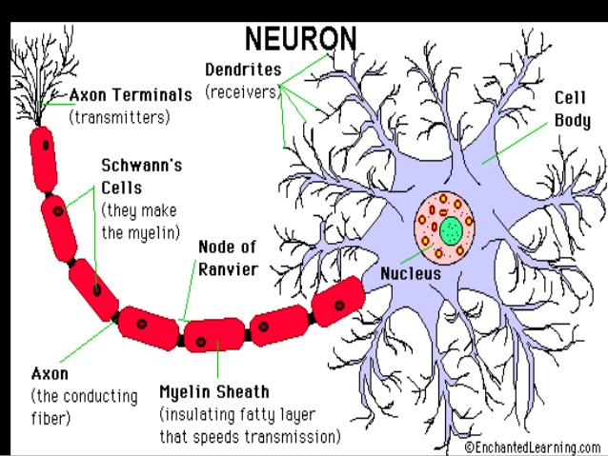
Thinner than dendrites, constant diameter, length from mm to several meter and diameter- 1-3 microns
Cytoplasm- axopasm- mitochondria and neurofibrils but not nissle substances.
axon is surrounded by a special type of cell called- schwann cells, produce myclin sheath around the large peripheral axons
Myelin made up of phospholipids, responsible for the white color for brain, spinal cord and nerves.
The sheath of sahwann and myelin sheath is interrupted by narrow 1 micron constriction called node of ranvier.
Axon

Slide 5
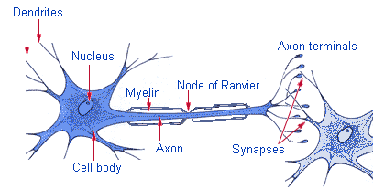
Axon terminals
Axons are ended by fine branches called axon terminals.
It responsible for the transmitting signals from neurons to neurons

Slide 6
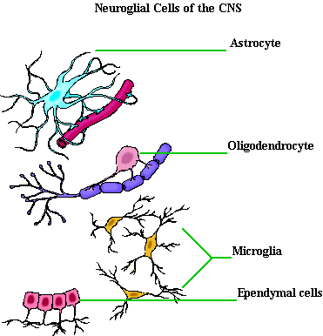

Slide 7
Supporting function of the neurons
The fill space between neurons provide insulation.
They increase in injury and diseases.
These are different types- oligodendroglia, microglia, schwann cells etc.
Function- nutritive support, limiting phagocyte and isolative.

Slide 8
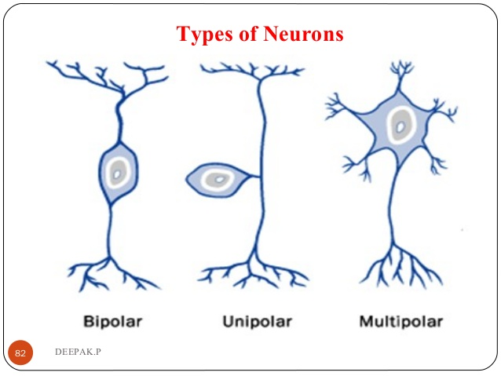
One axon and one Dendron on opposite poles
Single process of axon
One axon and many Dendron's

Slide 10
