Slide 1
Study Of Human Karyotyping
B. Sc. I
Dr. Narayan R. Mane
Department Of Zoology
GKG College, Kolhapur

Slide 2
There are 46 chromosome in the human i.e. 22 pairs of autosome and 1 pair of sex chromosome. In male is XY and in female it is XX.
Through improved cell culture technique and cytological technique, size and shape of chromosome could be fairly we defined. This is routinely done by taking dividing cell from cell culture so that chromosome can be seen. Dividing cell exhibit full compliment of 46 chromosoe. In mitosis, each chromosome has consist of two chromatids that remain attached to the centromer until anaphase.
Based on position of centromer the human chromosome are classified into 3 groups.
Metacentric (Centromer is at center)
Sub-metacentric (Centromer is near to center but not exactly at center)
Acrocentric (Centromer is near to end)
Depending on the size and centromeric position, human chromosome's are classified into 7 groups.

Slide 3
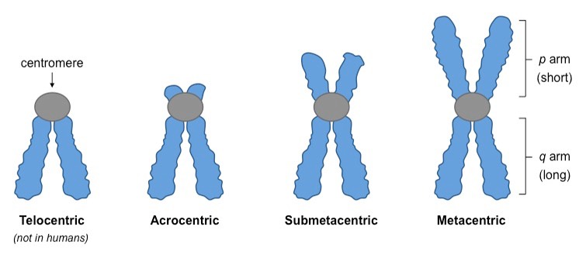

Slide 4
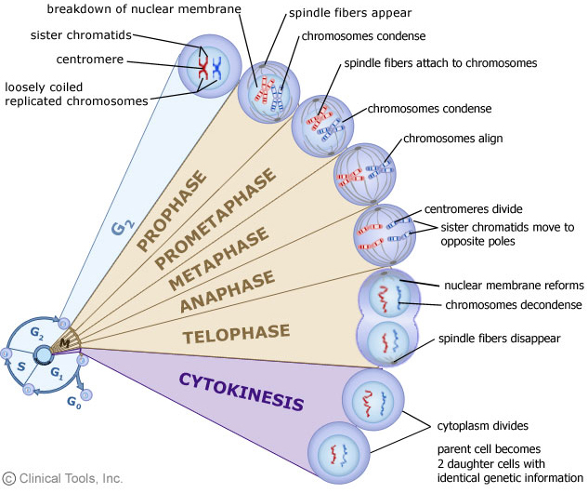

Slide 5
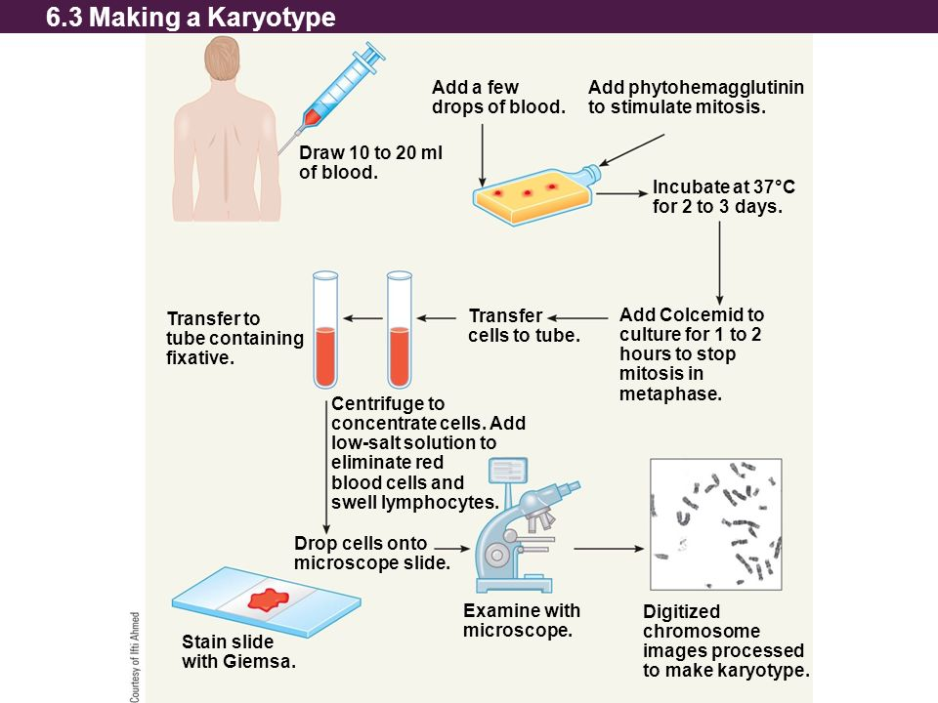

Slide 6
Group No. | Chromosomal Group | Group Designation | Size | Position of centromer
1 | 1-3 | A | Large | 1st & 3rd- metacentric 2nd- Submetacentric
2 | 4-5 | B | Large | Submetacentric
3 | 6-12 | C | Medium | Submetacentric
4 | 13-15 | D | Medium | Acrocentric
5 | 16-18 | E | Medium | 16th – Metacentric 17th & 18th - Submetacentric
6 | 19-20 | F | Short | Metacentric
7 | 21-22 | G | Very short | Acrocentric

Slide 7
Karyotype of normal male (46, XY)
Total Number of chromosome is 46
There is 22 pairs of autosome having disomy. Autosome are normal in appearance.
Sex chromosome are normal in apperance.

Slide 8
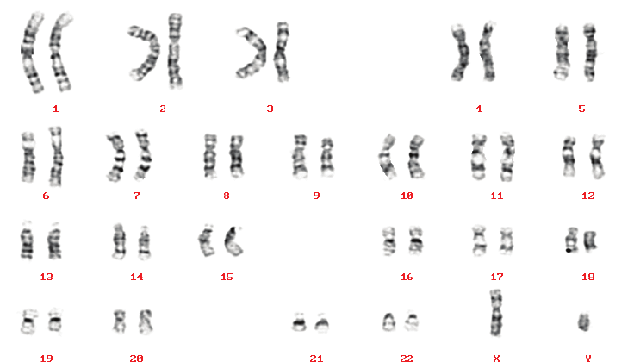

Slide 9
Karyotype of normal female (46, XX)
Total Number of chromosome is 46
There is 22 pairs of autosome having disomy. Autosome are normal in appearance.
Sex chromosome are normal in apperance

Slide 10
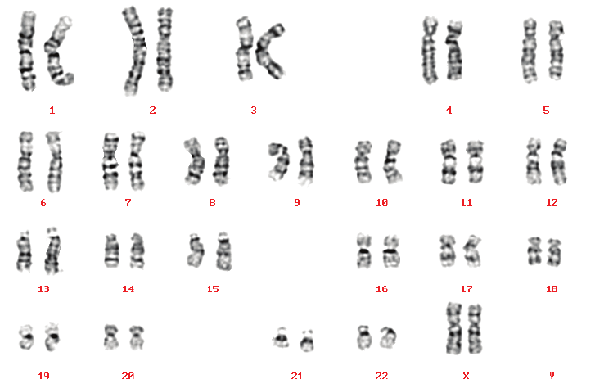

Slide 11
Karyotype of Down Syndrome
Total Number of chromosome is 47
There is 23 pairs of autosome having trisomy 21. Hence it is karyotype of Down syndrome.

Slide 12
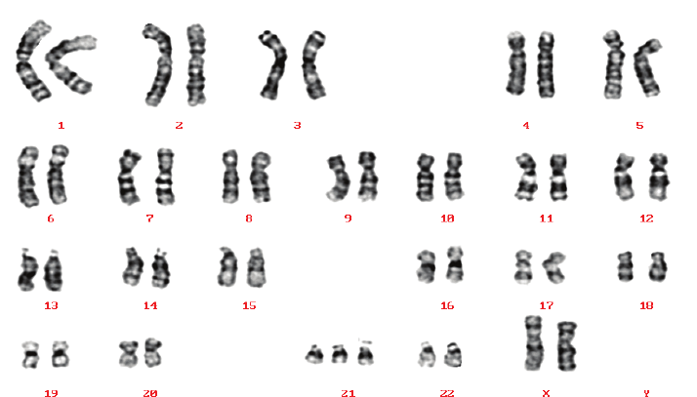

Slide 13
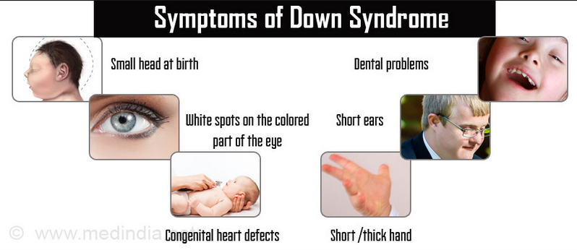

Slide 14
Karyotype of Edward Syndrome
Total Number of chromosome is 47
There is 23 pairs of autosome having trisomy 18. Hence it is karyotype of Edward Syndrome.

Slide 15
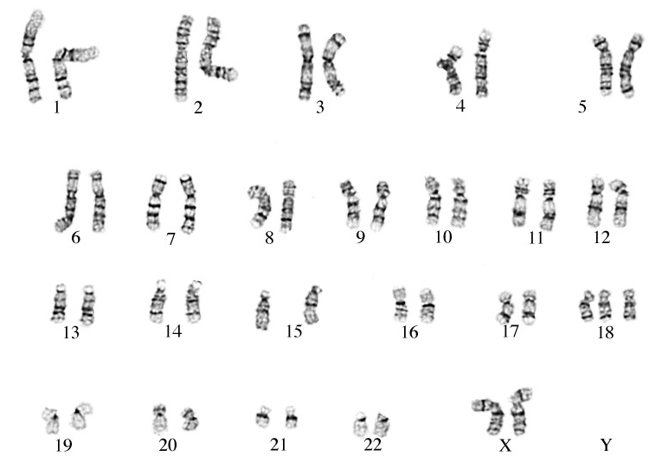

Slide 16
