Slide 1
ENTREPRENEURSHIP
AND
ENTREPRENEURS IN INDIA
DR. A. A. KULKARNI
HEAD, DEPARTMENT OF COMMERCE
GOPAL KRISHANG GOKHALE COLLEGE, KOLHAPUR

Slide 2
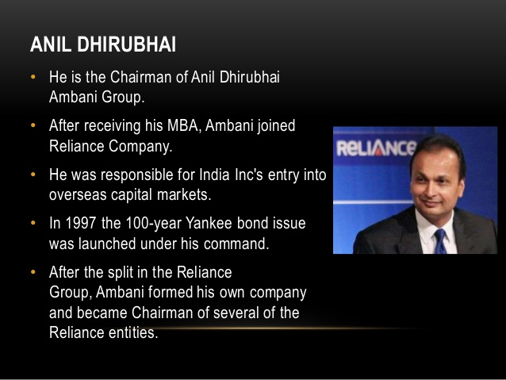

Slide 3
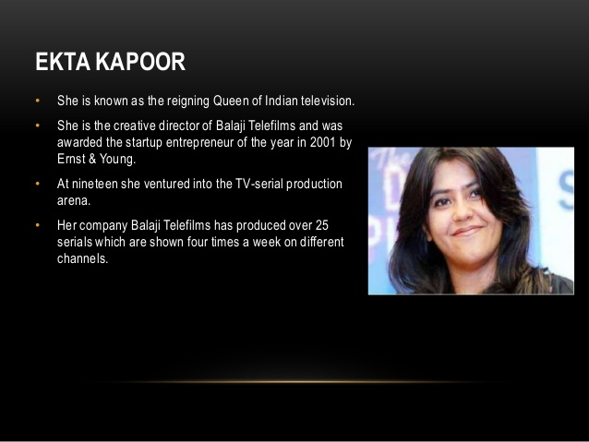

Slide 4
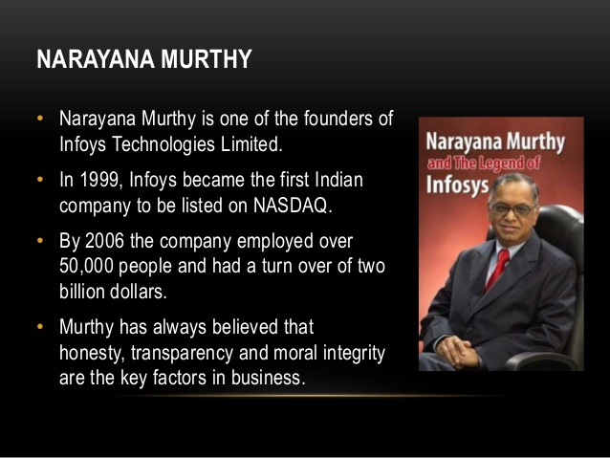

Slide 5
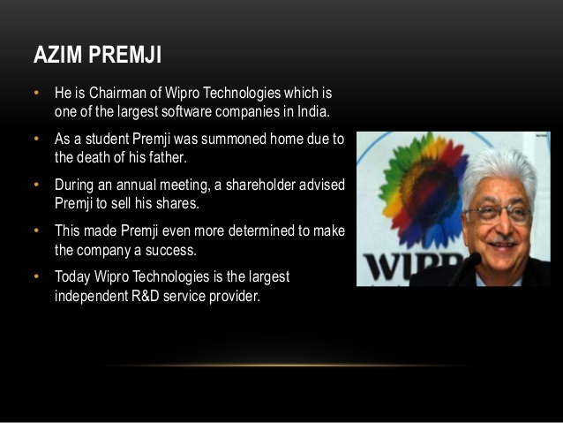

Slide 6
Entrepreneurship
“Is the process of creating something different with value by devoting the necessary time and effort, assuming the accompanying financial, psychic, social risks and receiving the resulting rewards of monetary and personal satisfaction and independence”

Slide 7
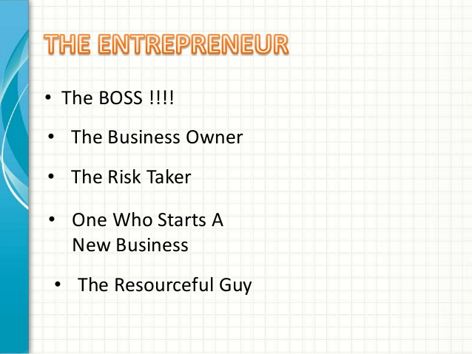

Slide 8
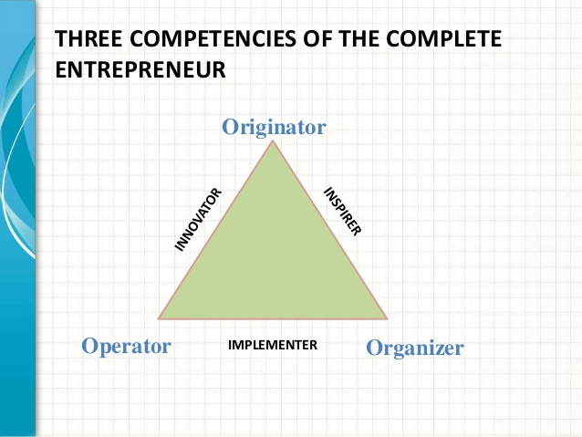

Slide 9
Key elements of entrepreneur
Innovation
Vision
Ethics & Values
Organizing Skills
Risk taking
Need for Achievement

Slide 10
Characteristics of an Entrepreneur
Mental ability
Clear objectives
Business secrecy
Human Resource ability
Communication ability
Technical knowledge
Achievement-oriented
Perseverance
Ethical
Motivator
Self-confident
Long term involvement
High energy level
Problem solver
Initiator
Goal setter
Risk taker

Slide 11
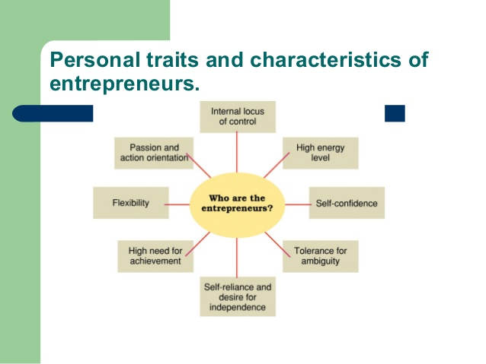

Slide 12
Advantages
of
Entrepreneurship

Slide 13
To an Individual
Self Employment
Employment for near & dear
Prolonged career for next generations
Freedom to use own ideas - Innovation and creativity
Unlimited income / higher retained income
Independence
Satisfaction

Slide 14
To the Nation
Provides larger employment
Results in wider distribution of wealth
Mobilizes local resources, skills and savings
Accelerates the pace of economic development
Stimulates innovation & efficiency

Slide 15
Factors favouring Entrepreneurship
Growth of education- science, technology & management
Developed infrastructure facilities
Financial assistance
Training facilities
Protective and promotional policies
Globalization

Slide 16
What makes a Successful Entrepreneur?
The urge for achievement
Determination to win
Win-Win Personality
Willingness to take moderate risks
Ability to identify & explore opportunities
Analytical ability to take strategic decisions

Slide 17
Perseverance
Flexibility
Capacity to plan and organize
Preparedness to undergo physical and emotional stress
Positive self concept
Future orientation: Vision
Ethics and Values :Mission

